Slide 1

Express.js serverio
kūrimas (1)
Dėstytojas
2 LYGIS
3 DALIS
Node.js

Slide 2
Šiandien išmoksite
JavaScript programavimo kalba
01
CRUD operacijos
02
Express.js (routes) maršrutai (1)

Slide 3

CRUD (Create, Read, Update, Delete) operacijos
Node.js
CRUD (Create, Read, Update, Delete) - Sukurti / Perskaityti/ Atnaujinti / Panaikinti operacijos
CRUD is an acronym for ways one can operate on stored data. It is a mnemonic for the four basic functions of persistent storage. CRUD typically refers to operations performed in a database or datastore, but it can also apply to higher level functions of an application such as soft deletes where data is not actually deleted but marked as deleted via a status. - Mozilla docs
Plačiau: https://en.wikipedia.org/wiki/Create,_read,_update_and_delete

Slide 4
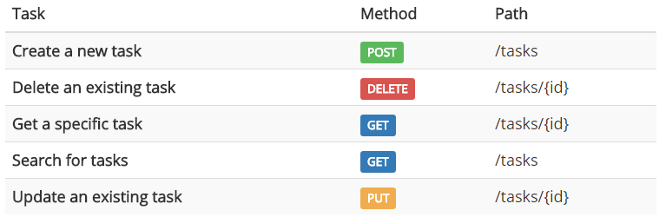
CRUD (Create, Read, Update, Delete) operacijos
Node.js
CRUD pavyzdys:

Slide 5
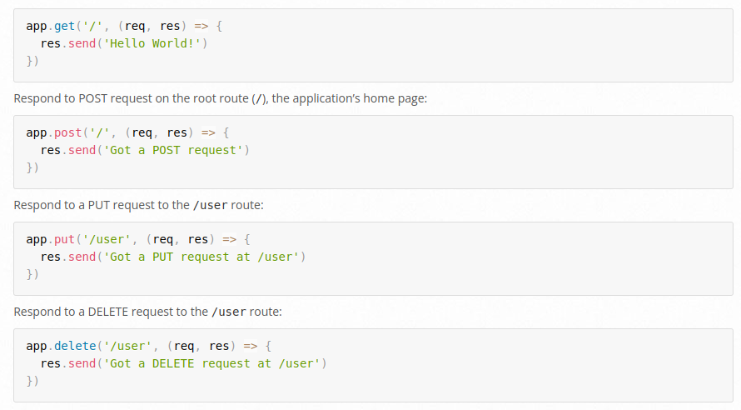
Express.js (routes) maršrutai
Node.js
Routing refers to determining how an application responds to a client request to a particular endpoint, which is a URI (or path) and a specific HTTP request method (GET, POST, and so on). - Expressjs docs
Docs: https://expressjs.com/en/starter/basic-routing.html

Slide 6
Naudinga informacija
Node.js
Informacija
https://en.wikipedia.org/wiki/Create,_read,_update_and_delete
https://expressjs.com/en/starter/basic-routing.html
https://www.codecademy.com/article/what-is-crud

